Slide 1
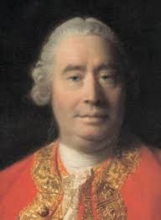
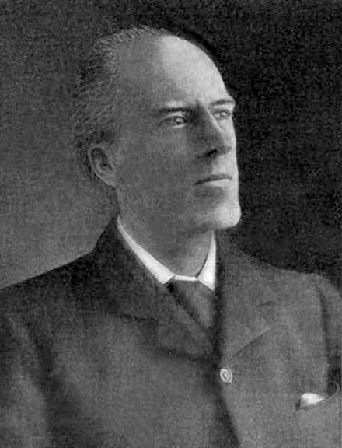
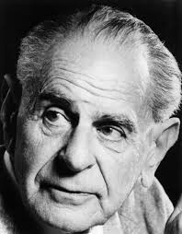
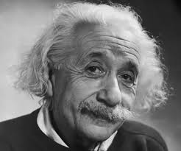
Causality
We call to mind the constant conjunction (of flame and heat) in all past instances. “Without any farther ceremony, we call the one cause and the other effect, and infer the existence of the one from that of the other.” David Hume 1739
“Beyond such discarded fundamentals as ‘matter’ and ‘force lies still another fetish amidst the inscrutable arcana of modern science, namely, the category of cause and effect.” ... “The ultimate scientific statement of description of the relation between two things can always be thrown back upon a contingency table.” Karl Pearson 1911
“The belief in causality is metaphysical. It is nothing but a typical metaphysical hypostatization of a well-justified methodological rule- the scientist's decision never to abandon his search for laws.” Karl Popper 1934
“Development of Western science is based on two great achievements: the invention of the formal logical system (in Euclidean geometry) by the Greek philosophers, and the discovery of the possibility to find out causal relationships by systematic experiment.” Albert Einstein 1953
1
Notes:
1
To keep the curious occupied until I start talking

Slide 2
Causality
Causality is an illusion arising from repeated temporal conjunction (Hume 1739)
Causality is outdated, correlation is all that is required (Pearson 1911)
Looking for scientific laws works. Causality is a metaphysical abstraction. (Popper 1934)
Learning causal relationships is central to science and we do it via systematic experiment (Einstein 1953)
A causal model is one that predicts the outcome of intervention in a system
2
Notes:
2
People have been philosophising about causality since we first started to develop scientific approaches to understand the world – Aristotle came up with a ‘theory of causality’ more than 300 years BC, but the question of what exactly is causality and what role it plays in the scientific endeavour is still debated.
Hume – saw no more to causality than noting which things follow after one-another.
Karl Pearson – often credited with founding modern mathematical statistics – viewed causality as an outdated and unnecessary concept and believed that the relationship between variables can be encoded purely in terms of contingency tables –or correlations.
To Karl Popper – the famous philosopher of science – the search for scientific laws is justified (on the basis that they are falsifiable) and the notion of causality is a metaphysical abstraction without concrete meaning.
Finally, Einstein viewed learning causal relationships as central to science – and way to discover them as systematic experiment.
This is a talk about causality in machine learning – so we will take a very pragmatic view on what causality is. Any model that predicts the outcome of an intervention in a system is causal.
From this interventioalnist perspective, I’ll show how temporal conjunction and correlation can be misleading, how we can use causal graphical models to give questions of causality a concrete formulation and demonstrate why experimentation plays such a central role in building causal models of the world.
Causality may be an illusion – the idea of intervention is in some sense an artefact introduced by our failure to include the entire universe in our models. However, (at least under the assumption that we are capable of making decisions and manipulating the world) – causal models make useful tools.

Slide 3
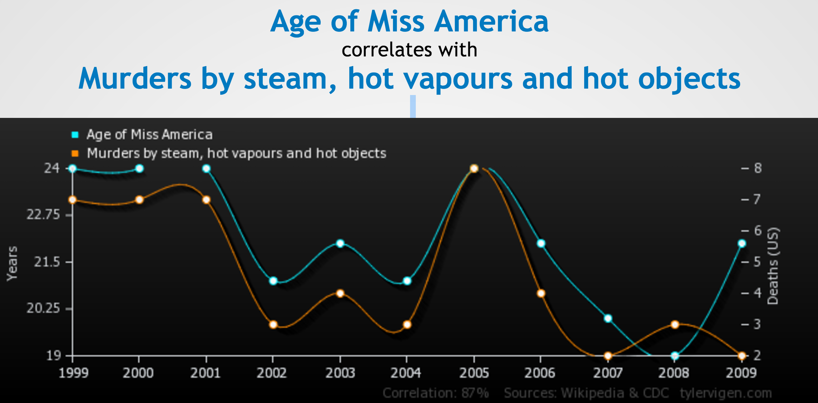
Correlation is not causation
Image source: www.tylervigen.com/
3
Notes:
3
There two key ways in which an observed correlation may not be causal.
The first is a form of overfitting – if we hard enough in a finite sample we can find variables that are completely unrelated but are correlated in a given sample by chance. This form of spurious correlation can be addressed by techniques such as cross-validation, or replication studies.
However, we can also have variables that demonstrate persistent correlation – out of sample or in replication studies and yet are not causally related. In this chart I have plotted the reading ability of school age children against their height in cm – and I would be happy to guess that a relationship of roughly this form would hold if we were to go out and conduct a survey in a local school. But what is the relationship between these variables if we intervene on them. If we improve a child’s reading score by giving them intensive tuition – we do not expect to see a corresponding increase in height and similarly if we gave a child growth hormones to make them taller, we wouldn’t expect dramatic improvements in reading ability. What’s going on here is that there’s another variable – age – that is driving both height and reading ability.
Temporal conjunction can be a very useful tool in figuring out the causal relationships between things– and people are known to rely on it heavily. However, if we strictly follow Hume – there is nothing wrong with the statement that the rooster’s crow causes the sun to rise.

Slide 4
When do we care about causality?
Forecasting the weather
Image classification
Predicting which patients are at risk of death from pneumonia
4
Notes:
4
Lets do a little survey – who thinks forecasting the weather requires a causal model?
So this was a trick question – because I didn’t give you a critical piece of information required to answer it – namely how will any model we build be used - what action will be taken in response predictions we might make.
We almost always want to take some action in response the predictions we produce with a model – otherwise what are we building it for?
In order to determine whether or not we need a causal model - the first question we need to ask is – will acting on the basis of the models predictions change the original system?
Image classification is an example of a problem for which machine learning has been extremely successful – and where the assumption that acting on model predictions doesn’t change the system (at least quickly) may often be reasonable.
How should we change our treatment protocols to reduce the death rate from pneumonia?
How will we respond to predictions of offence whilst on parole?
Expand or dispense with various prison rehabilitation programs
Suggest changes to sentencing guidelines
Use is as part of the decision to grant/deny parole

Slide 5
When do we care about causality?
Forecasting the weather
Image classification
Predicting which patients are at risk of death from pneumonia
The real question is “when don’t we care?”
5
Notes:
5
Ask audience – what do they think
So this was a trick question – because I didn’t give you a critical piece of information required to answer it – namely how will any model we build be used - what action will be taken in response predictions we might make.
We almost always want to take some action in response the predictions we produce with a model – otherwise what are we building it for?
The first question we need to ask is – will acting on the basis of the models predictions change the original system we modelled?
Image classification is an example of a problem for which machine learning has been extremely successful – and where the assumption that acting on model predictions doesn’t change the system (at least quickly) may often be reasonable.
How should we change our treatment protocols to reduce the death rate from pneumonia?
How will we respond to predictions of offence whilst on parole?
Expand or dispense with various prison rehabilitation programs
Suggest changes to sentencing guidelines
Use is as part of the decision to grant/deny parole

Slide 6

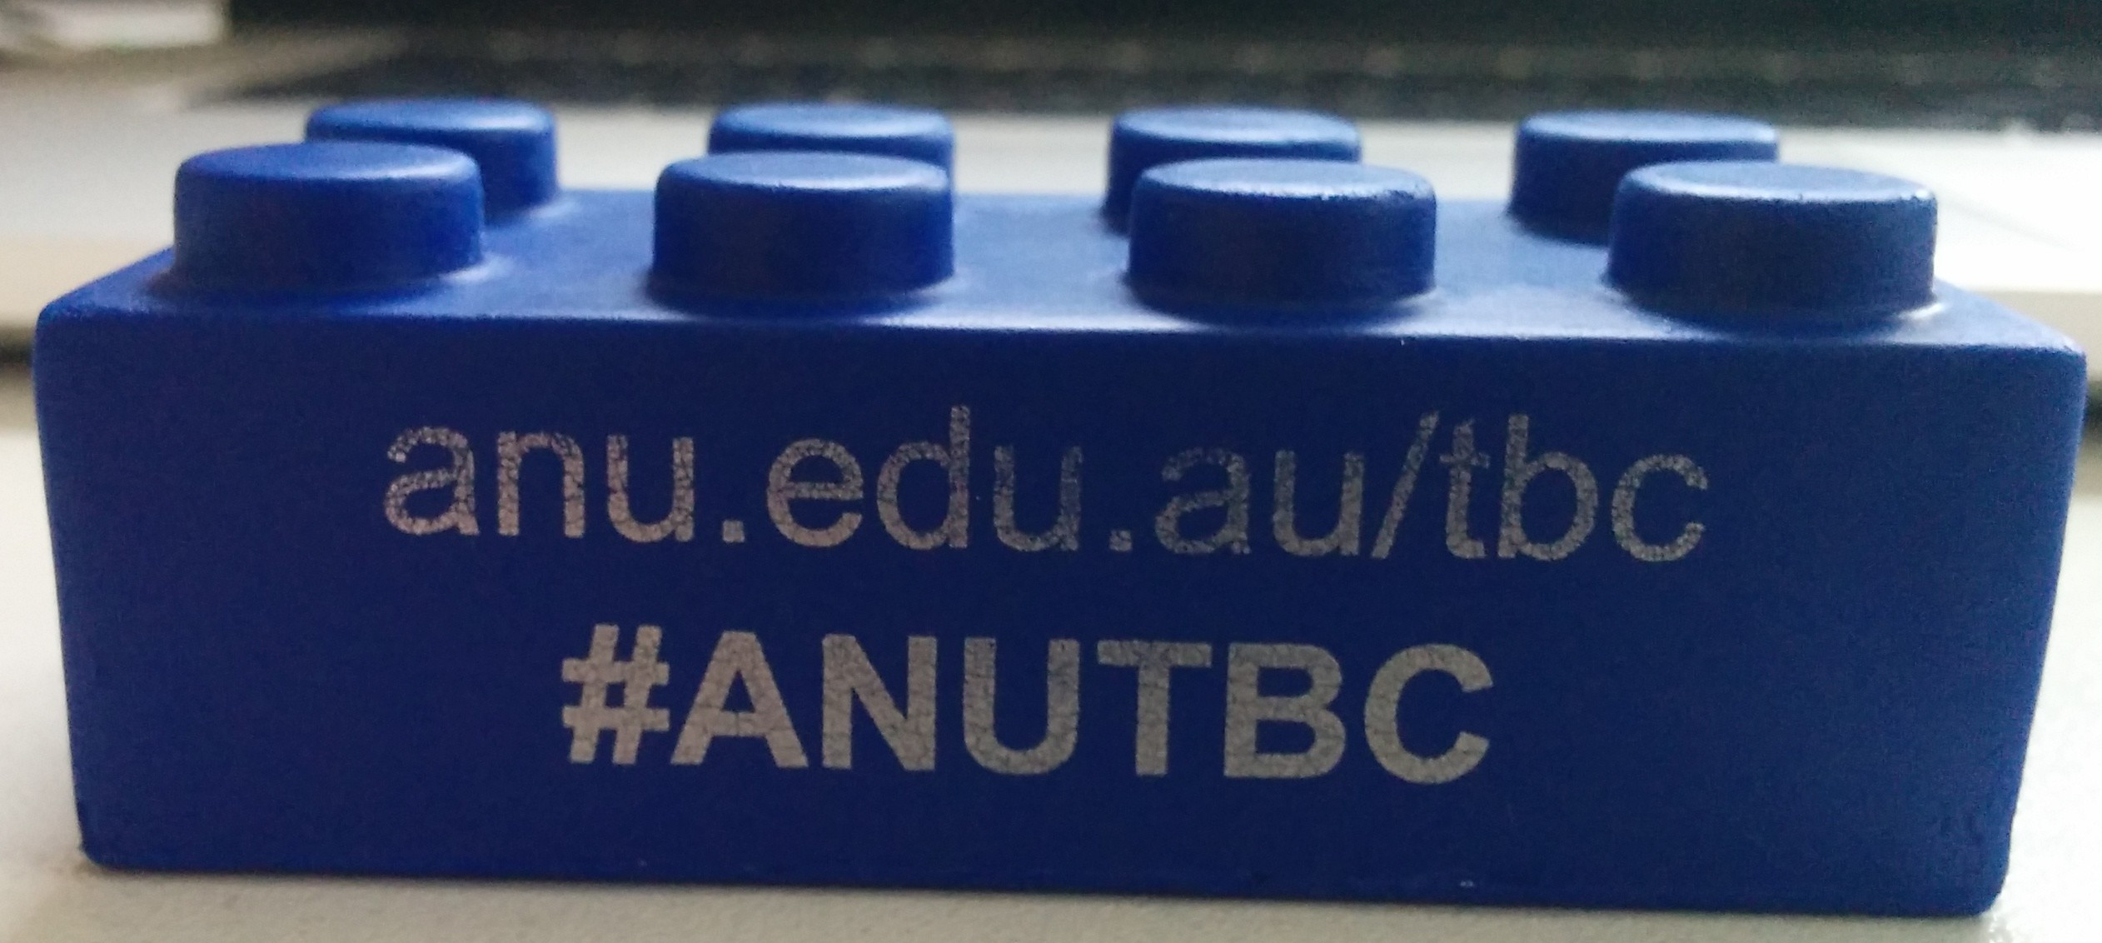

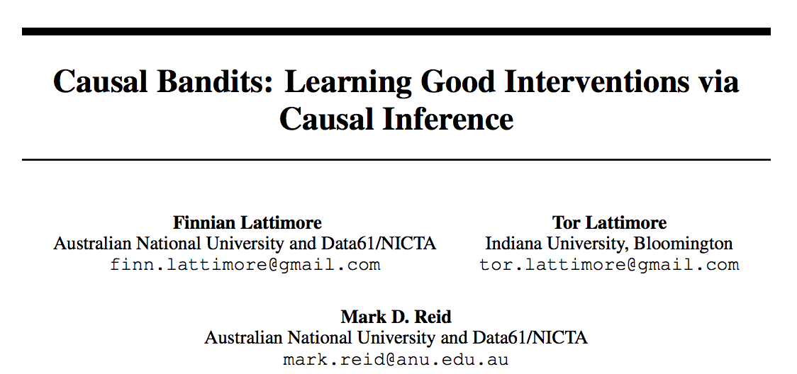

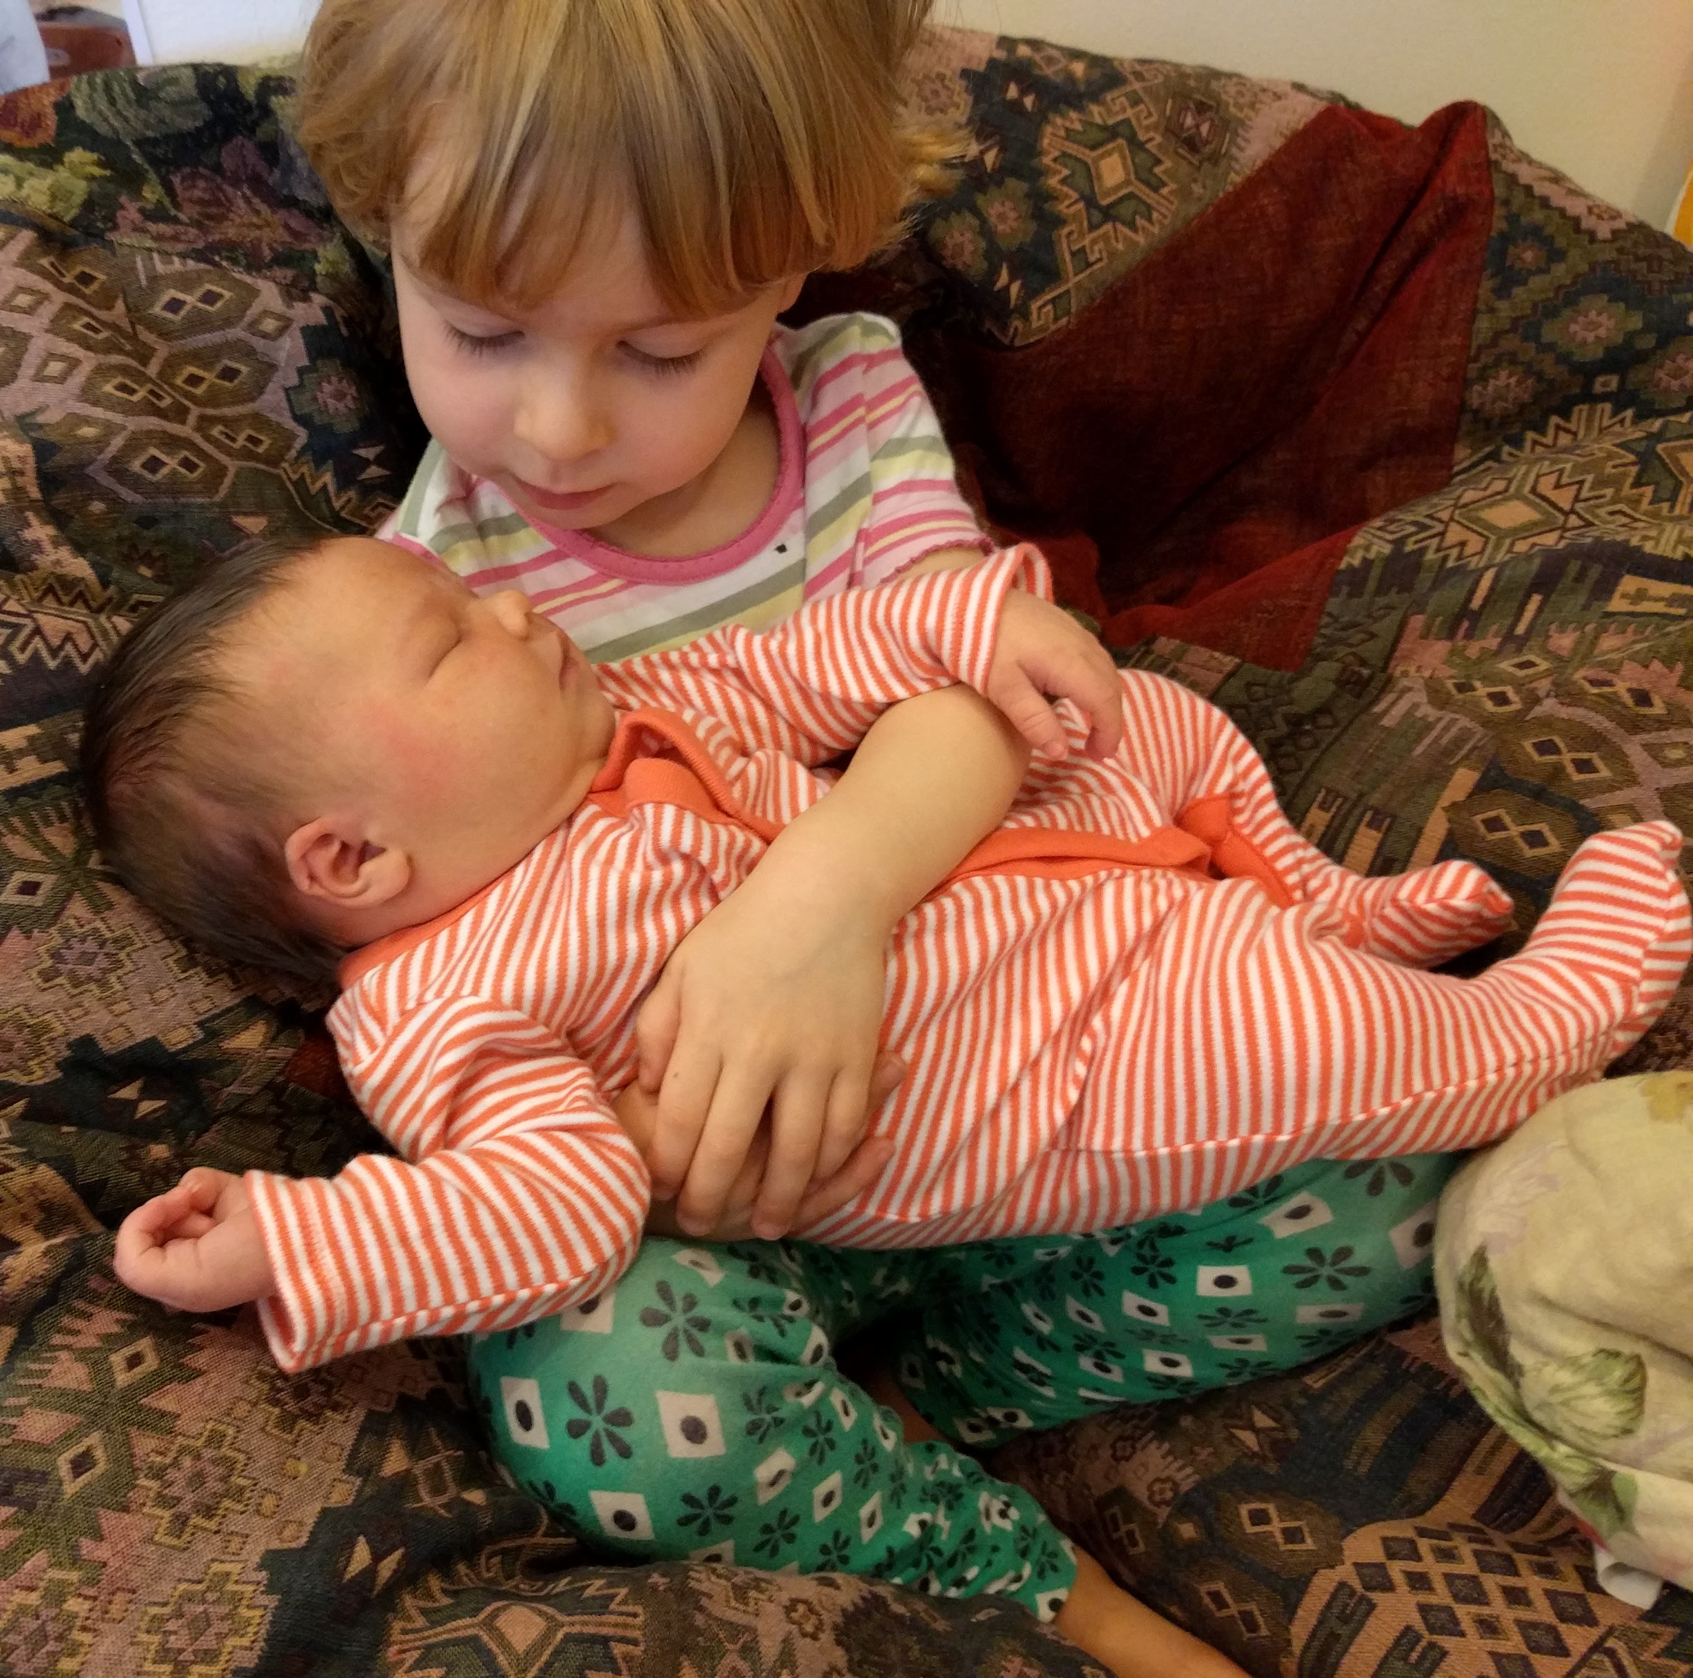
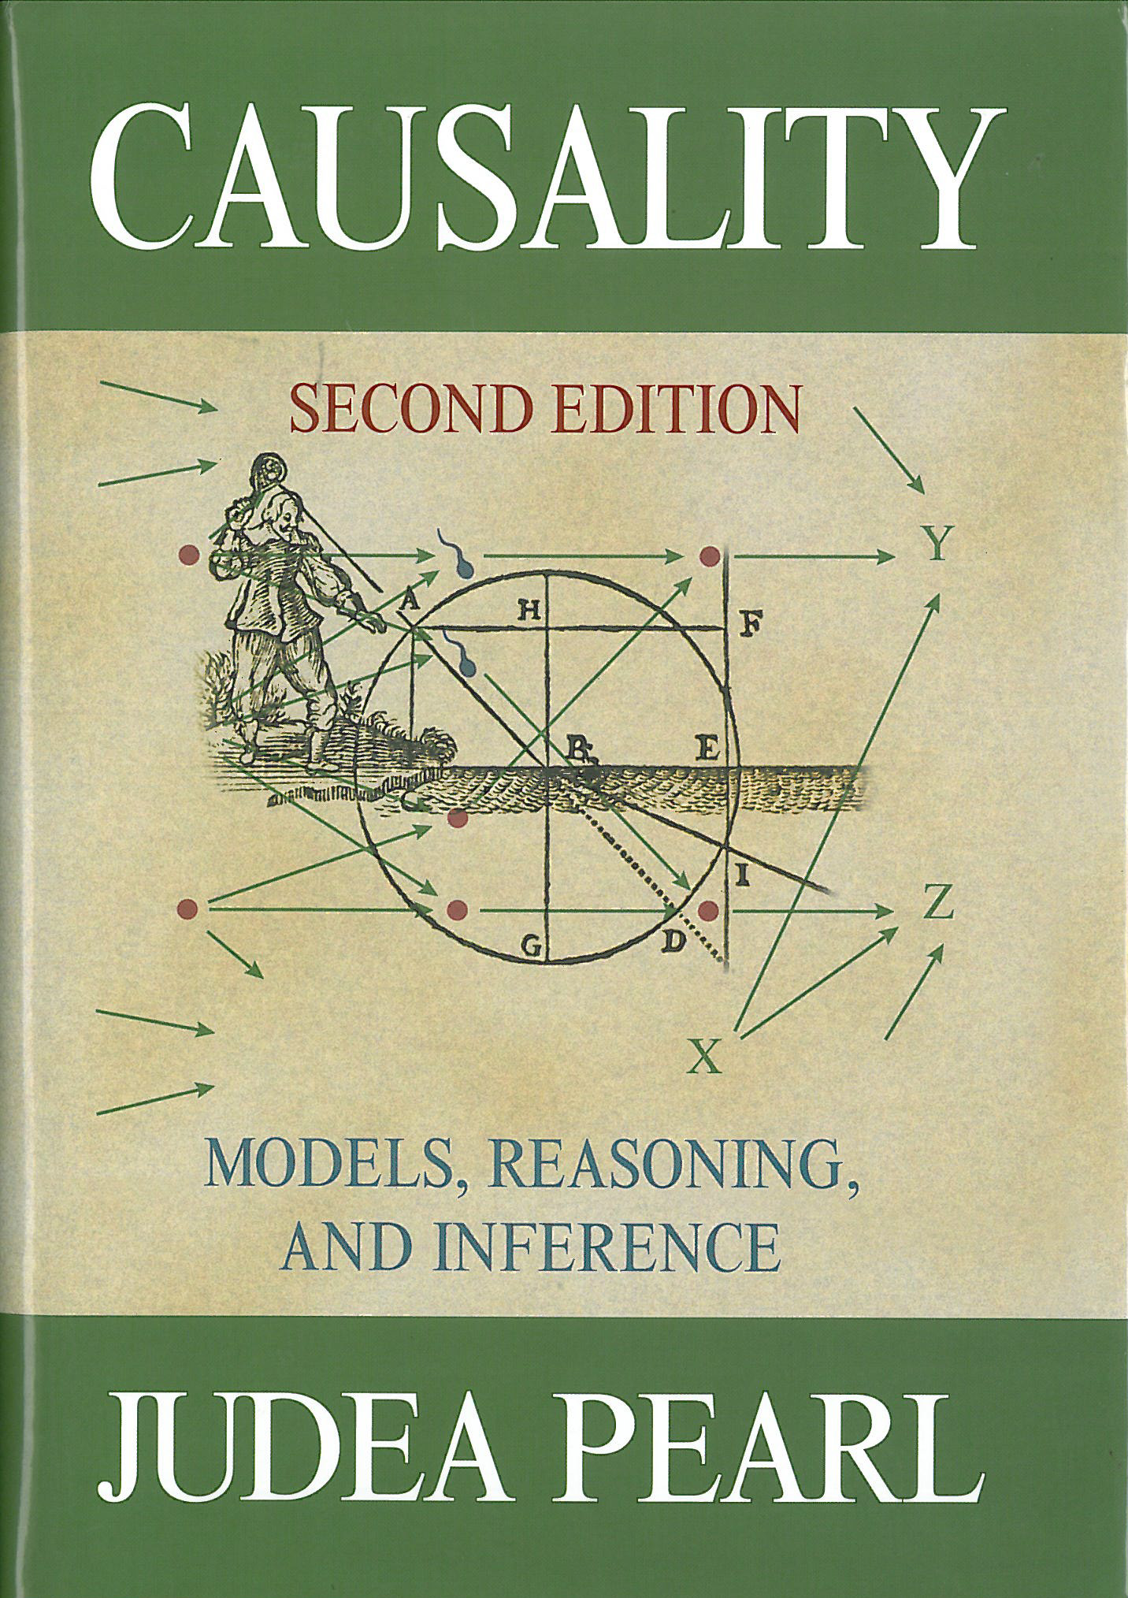
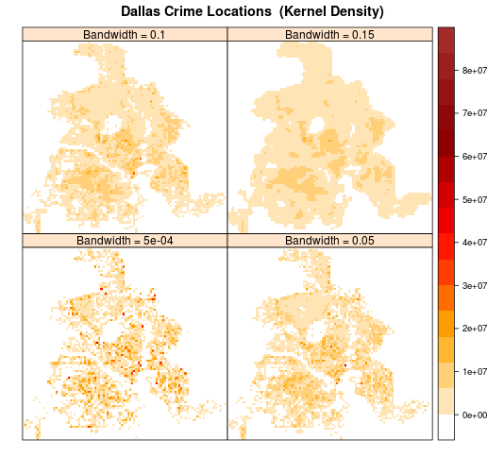


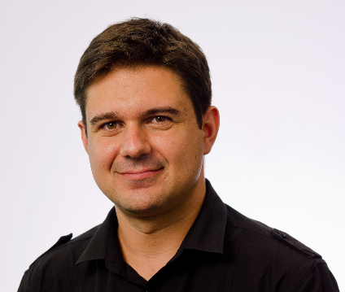
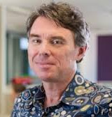
Trajectory of a PhD
6
Notes:
6
This is my PhD completion seminar – like most PhD’s this one didn’t follow a clear trajectory from start to finish. I started out working on a practical problem of crime prediction –but nothing seemed to beat careful implementation of logistic regression + KDE which was not very exciting – then I got interested in causality and started something conctete to work on there – there was an interruption in the arrival of my second daughter – finally got a paper on causal bandits into NIPS, then an internship with Ambiata where I’ve been working on measuring the causal effect (or otherwise) of marketing on sales – but kept plugging away on the thesis – in particular for anyone preparing write I recommend ANU thesis bootcamp where in terms of total words, roughly a third of my thesis was written over one weekend – and now I’m close to the point where it hopefully joins the stash of knoweledge in the library.
And for helping me get this far I want to thank my supervisors, Cheng, Mark and Tiberio and to Bob for chairing my panel
Started outs with a practical crime prediction problem – but nothing seemed to beat careful implementation of logistic regression + KDE.
Then got interested in causality – started hunting for a concrete idea.
Interruption with a rough pregnancy and then new baby.
Finally – got a paper on causal bandits into NIPS
Then an internship with Ambiata, where I worked on– now ongoing
Thesis boot camp where - in terms of raw words - I got down roughly a third of my thesis over one weekend.

Slide 7
Contributions
A synthesis of the observational and interventional approaches to learning to intervene that combines causal graphical models with multi-armed bandits.
Clarifying the causal assumptions underlying previous bandit formulations.
Demonstrating the role a graphical framework for causality can play in Bayesian inference.
7
Notes:
7
My key contribution is a unified approach to learning to intervene that observational causal inference in the form of causal graphical models, with the interventional approach of multi-armed bandits. I clarify the causal assumptions underlying previous bandit formulations and demonstrate that knowledge of the causal relationship between variables introduces an interesting form of structure into bandit problems that is not leveraged by existing algorithms.
I also demonstrate the role a graphical framework for causality can play in Baysian inference and show how we can introduce bias if we do not take care in how we apply Bayesian inference to causal problems.

Slide 8
Overview – Causal inference in ML
What is causality?
Predicting the outcome of interventions
Why should we care in machine learning?
Because we want to act in response to our models
Observational causal inference
Interventional causal inference
A unified approach - Causal Bandits
8
Notes:
8

Slide 9
Observational causal inference
9
Notes:
9

Slide 10
Causal Bayesian Networks
Truncated product formula: drop terms for intervened variables from the factorisation.
A CBN represents the set of all possible interventional distributions over its variables
10
Notes:
10
Consider specific forms of interventions – namely ones that force the value of certain variables to some value
highlight what remains invariant
D-seperation allows us to localise the effects of what has changed.

Slide 11
Can the effect of X on Y be identified?
The do calculus is a set of three rules that specify what conditional distributions are equivalent pre and post-intervention based on properties of the graph.
11
Notes:
11
Combining the definition of what an intervention does in a causal graph – with the properties of Bayesian networks, which causal bayesian networks inherit – in particular d-seperation, leads to the do calculus.
The do calculus is a set of three rules that specify what conditional distributions are equivelent pre and post-intervention based on properties of the graph.
We can use the do-calculus to get answer the question, is it possible with infinite observational data and positive density assumptions, to get a point estimate for the causal effect of one variable on another.
The do calculus identifies equivalencies between observational and interventional distributions, based only on the structure of the causal graph – it does not rely on any assumptions about the functional form of the relationship between the variables – for example linearity. What’s more its complete – a given post-interventional distribution is non-parametrically identifiable if and only if we can get an expression for it in terms of pre-interventional distributions by repeated application of the do-calculus – and there’s an algorithm to do this – so you draw the graph, say which variable you are intervening on and the outcome distribution you care about, run the algorithm and it either spits out a formula for computing it in terms of observational quantities or says that its not identifiable.
The do notation is just a notation – the question is can properties of one system be inferred from another.
Explain the localisation property of d-separation.
The do calculus is complete

Slide 12
Inference from observational data – aka Pearl
12
Notes:
12

Slide 13
Can’t we just be Bayesian?
13
Notes:
13
Causal graphical framework allows us to combine assumptions with data to learn about a system after some intervention without actually doing it. But we already have a very general approach to combining assumptions with data – can’t we just be Bayesian? Why do we need a special framework for causality?
In some sense we don’t. We can represent the assumptions about how a given system is related pre and post-intervention explicitly with normal Bayesian networks. This example represents an intervention on X.
But to do this, we have to figure out and specify what invariance assumptions will hold ourselves, for every instance of causal problem we face. We lose the advantage that causal graphical models provide, of localising the effect of an intervention in a network and the do calculus – that lets us determine if and how we can map between observational and interventional distribution based only on the structure of the causal graph.
Bayesian inference methods and causality are not incompatible – we can draw a causal graphical models and use the do-calculus to figure out how to map from observation to intervention – and then use Bayesian estimation techniques to address the pesky statistical issues associated with finite data. But we have to be do have to take care when setting priors how we combine causal intuition with estimation. I have an example that demonstrates this – which I’ll skip in the interests of time but the key is that applying causal intuition to set priors without considering the possibility of latent confounders can result in biased estimates.

Slide 14
Careful with that prior
The goal is to estimate the causal effect of X on Y
It is indefinable via the do-calculus
14
Notes:
14

Slide 15
Careful with that prior
3
-1
0.5
0.47
Prior centered on causal effect
Improper prior
No/Improper prior
15
Notes:
15

Slide 16
Where are we up to?
What is causality?
Predicting the outcome of interventions
Why should we care in machine learning?
Because we want to act in response to our models
Observational causal inference
Leveraging invariance assumptions to map properties from a system pre-intervention to the system post-intervention
Interventional causal inference
A unified approach - Causal Bandits
16
Notes:
16

Slide 17

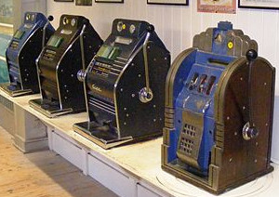
The interventional approach to causality
Randomized trials are the traditional gold standard for determining causality
Bandits?
17
Notes:
17
The key function of randomisation is to break the link with any confounders - the true key is explicit control of actions.
Bandits algorithms also explicitly assign actions and typically utilize randomization – but also account for the sequential nature of decision processes.

Slide 18
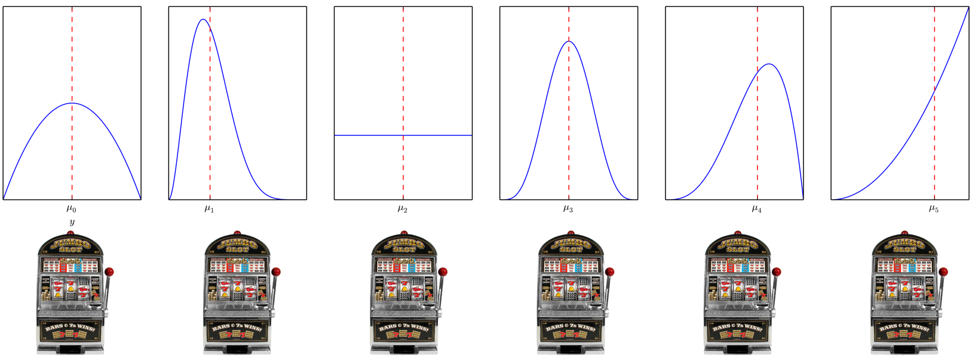
Classic Multi-armed Bandits
18
Notes:
18

Slide 19
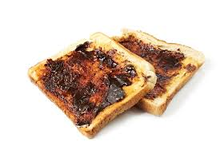
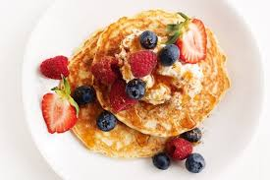
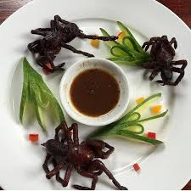
What should we suggest for breakfast?
Explore-exploit trade-off
Non i.i.d data
Simple Regret
19
Notes:
19
Multiarmed bandits are really interesting – for such a seemingly simple problem they have surprising complexity and depth – apparently allied scientits thinking about bandit problems during the war found them so intractable that they proposed dropping the problem over Germany so that scientists there would also waste their time on it.
Approaches
Explicitly separate exploration and exploitation
UCB (optimism in the face of uncertainty)
Sample from some weighted combination of the actions (Exp3 & Thompson sampling)
Eliminate sub-optimal actions
These techniques can be applied with very general assumptions about the nature of the reward distributions (ie that they are sub-gaussian) – need to be sensible enough that expectation and variance are properly defined.
Bandits are RL with immediate feedback (or single state MDPs)

Slide 20



Contextual Bandits
20
Notes:
20
There are many variants of the bandit problem
Adversarial – instead of the environment generating rewards purely stochastically – think of it as an adversary, who knows your algorithm and can try to design the distribution of rewards to thwart you.
Contextual bandits – we can observe some characteristics of the individual before we select an action – the naïve solution (for discrete context) is to run an independent bandit algorithm for each possible value of context.
Off-policy evaluation

Slide 21
Causal structure of bandit problems
The rewards for standard bandits need not be independent.
Contextual bandit algorithms do not require that the context is a cause of the outcome.
21
Notes:
21
Standard bandits don’t require that actions are independent – imagine X_t is latent, then we have a standard bandit problem – but the a

Slide 22
Where are we up to?
What is causality?
Predicting the outcome of interventions
Why should we care in machine learning?
Because we want to act in response to our models
Observational causal inference
Leveraging invariance assumptions to map properties from a system pre-intervention to the system post-intervention
Interventional causal inference
Learning by doing
A unified approach - Causal Bandits
22
Notes:
22

Slide 23
Why unify causal graphs and bandits?
Regret grows linearly with the number of actions
There is a lot of data available for which we do not control/know the process selecting actions
Bandits are a nice subset of general RL problems
23
Notes:
23
Regret increases linearly with the number of arms (problem dependent regret does) – this is bad when we have exponentially many actions to explore.
Do we really need another flavour of bandit?

Slide 24
Causal Bandit Problems
Every (allowable) assignment of variables to values is a bandit arm.
Reward is value of a single specified node in the graph after the action.
24
Notes:
24

Slide 25
How can causal structure be leveraged
Prune actions before commencing
Obtain information about the reward for one action by selecting another.
25
Notes:
25
If the goal is to reduce cancer – we do not have to consider any interventions involving asthma, or intervention on poverty if we already control smoking and diet.

Slide 26
C-Bandit problems with post-action feedback
Problems for which additional feedback available only after action selected (no context).
26
Notes:
26
Simple regret arises in best-arm identification or pure-exploration problems – where we can explore without penalisation during some training period and must then identify an optimal arm. It arises in practise in settings in which we can simulate data – or where the overhead of a ‘experimental’ period is high – such that we want to identify the best option during a learning phase and then select that option from then on.
Best-arm identification still has an explore-exploit trade-off – we are still not trying to learn about the rewards of all arms (we only need to learn about plausibly optimal arms) but it’s a subtly different to the one for cumulative regret.

Slide 27
The parallel bandit problem
27
Notes:
27

Slide 28
The parallel bandit problem – algorithm
Observe for first T/2 rounds to estimate reward for actions that occur frequently naturally.
Uniformly explore infrequent actions in remaining rounds.
But how do we define infrequent?
28
Notes:
28
Find the index at which q[indx] > 1/index

Slide 29
The parallel bandit problem – regret bounds
Parallel bandit
Standard bandit
29
Notes:
29
See that the approach is order optimal (worst case).

Slide 30
General graphs - challenges
We could map from observation to intervention via the do-calculus but,
Its no longer optimal ignore the information intervening on one variable can provide about another.
30
Notes:
30

Slide 31
General graphs - challenges
31
Notes:
31
The point is that P(X_2 = 1) = 0.5

Slide 32
General graphs - solution
32
Notes:
32
This is a strong assumption – but there are cases in which it is realistic, ie a company may be able to control a range of levers and know how each of these levers impact a number of characteristics of their business – but not how some external quantity might respond.

Slide 33
General graphs - solution
General CB upper bound
Standard lower bound
33
Notes:
33
m(eta*) is the minimum worst-case variance of the importance weighted estimator – also an effective number of arms.

Slide 34
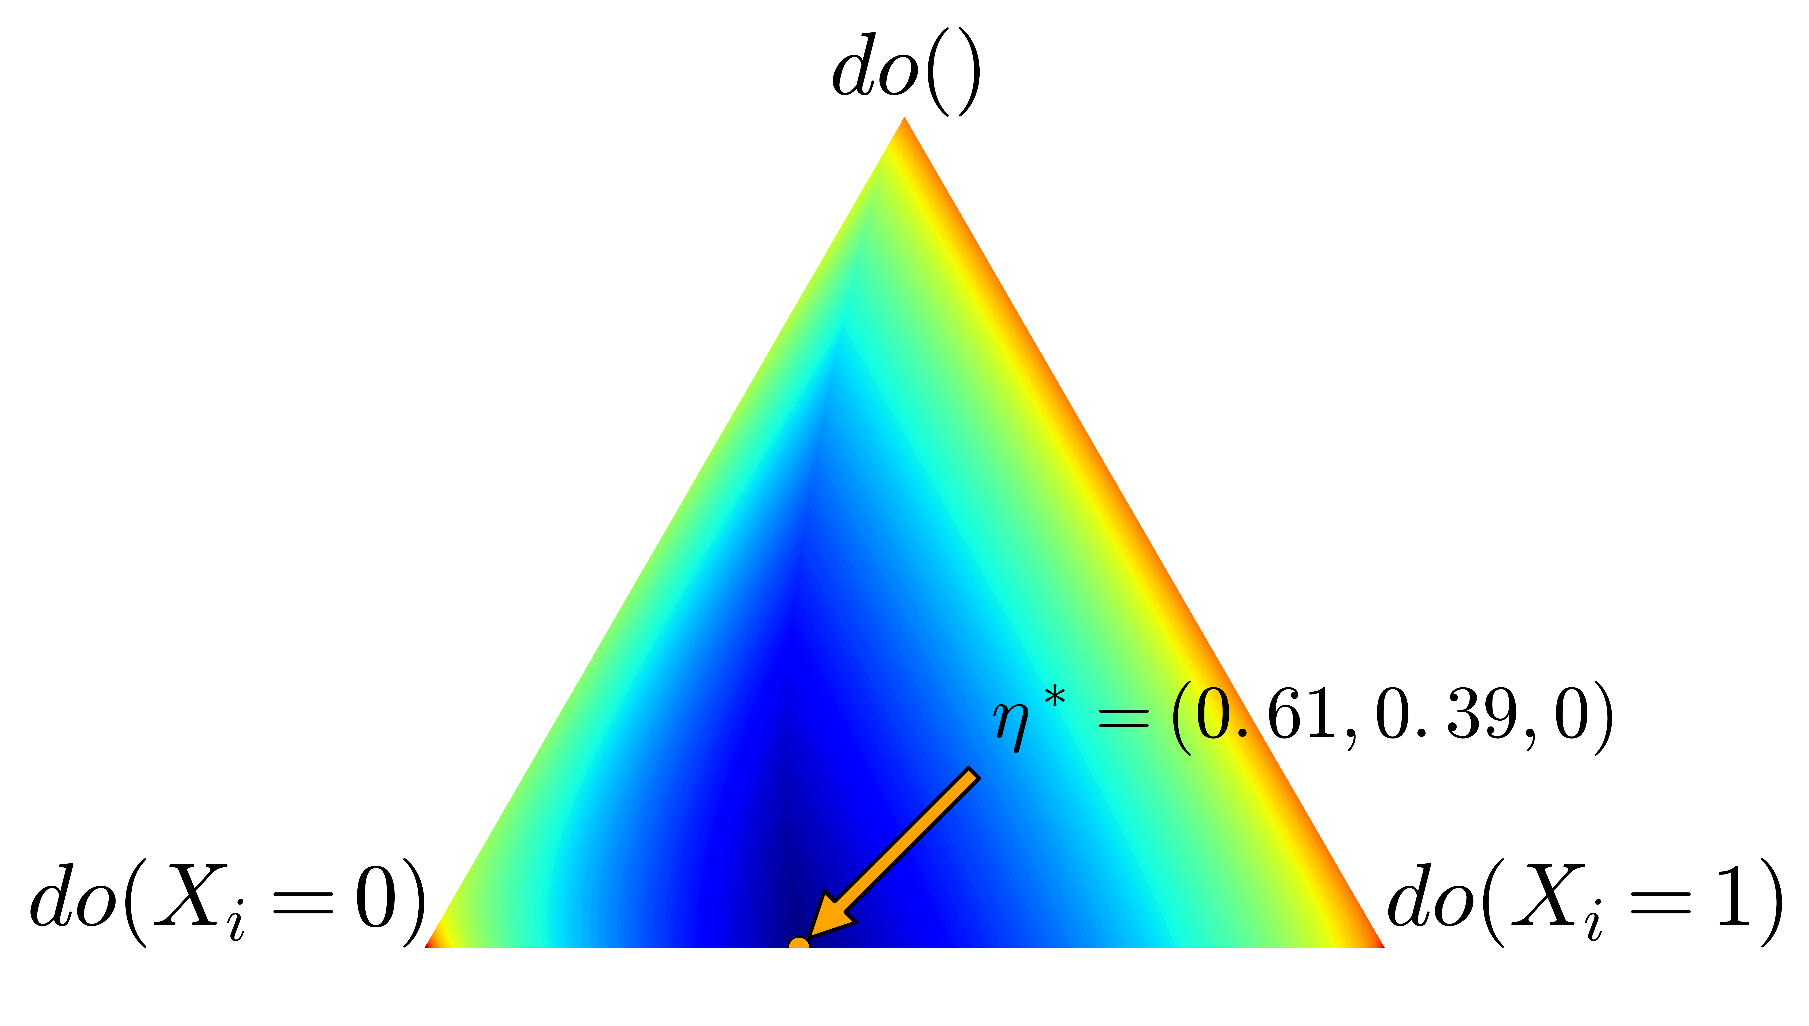
General graphs - solution
34
Notes:
34
There are 7 actual arms. m(eta*) is 3.8 in this setting.

Slide 35
Experiments
35
Notes:
35
m(eta*) is the minimum worst-case variance of the importance weighted estimator – also an effective number of arms.

Slide 36
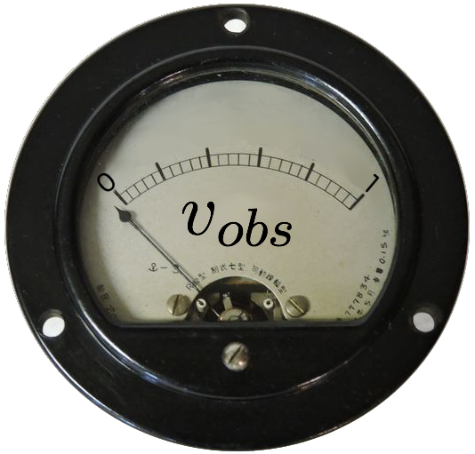
Quantifying the value of intervention
36
Notes:
36

Slide 37
Conclusion
What is causality?
Predicting the outcome of interventions
Why should we care in machine learning?
Because we want to act in response to our models
Observational causal inference
Leveraging invariance assumptions to map from properties from a system pre-intervention to the system post-intervention
Interventional causal inference
Learning by doing
A unified approach - Causal Bandits
Bandits and causal observational inference fundamentally solve the same problem – learning to intervene
Adding structure to bandit problems with causal graphical models allows us to explore large action spaces much more quickly
37
Notes:
37

Slide 38
Open questions
Relaxing the assumption that the interventional distributions are known
Contextual causal bandit problems
Cumulative regret
Extensions to MDPs
Connections between causal effect estimation and off-policy evaluation
38
Notes:
38
The optimism principle breaks when we have information sharing across arms.
There is a general principle that could be applied to minimize Bayesian regret – Information direct sampling
Its important to put these two parts together because, from a bandit perspective, structure is needed to make learning how to act feasible in realistic problems with many potential variables to control – and potentially exponentially many actions - and from a observational causal inference perspective because not everything can be learnt from observational data.
Could we use the corelling bandit approach – such that if the assumption is wrong we switch to using the better estimation method?

Slide 39
Questions
?
39
Notes:
39

Slide 40
The do calculus (simplified)
40
Notes:
40
Things are more interesting when there are latent variables
The do notation is just a notation – the question is can properties of one system be inferred from another.
Explain the localisation property of d-separation.
The do calculus is complete

Slide 41
Pesky statistical issues
Training data
Test data
41
Notes:
41
TODO make labels larger

